Slide 1

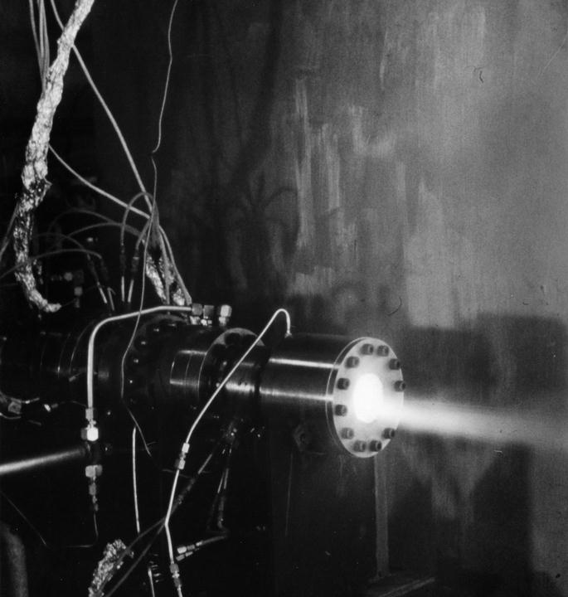

Mike Byrd, ByrdNest Consulting
A Self-Tuning Fill Factor Technique for SQL Server
© 2020 | ByrdNest Consulting

Slide 2


Who is Mike Byrd???
In former times:
Rocket Scientist
USAF Fighter Pilot (lived in Germany 4.5 years)
Tech writer for PC Magazine
CTO, Texas Windstorm Insurance Company
Part-time Database Consultant/Trainer
Blogging: https://logicalread.com/ & http://www.sqlservercentral.com/
Digging deeper into the optimizer black box!
Just basically a SQL Performance Geek!
© 2020 | ByrdNest Consulting

Slide 3

Contact Info:
Mike Byrd
213 Lakeview, Sunrise Beach, Texas 78643, USA
512-657-5349
MByrd@ByrdNest-TX.com
www.TSQLMentoring.com
LinkedIn: http://www.linkedin.com/pub/mike-byrd/1/aa0/bbb
Twitter: @ByrdNest_TX
© 2020 | ByrdNest Consulting

Slide 4


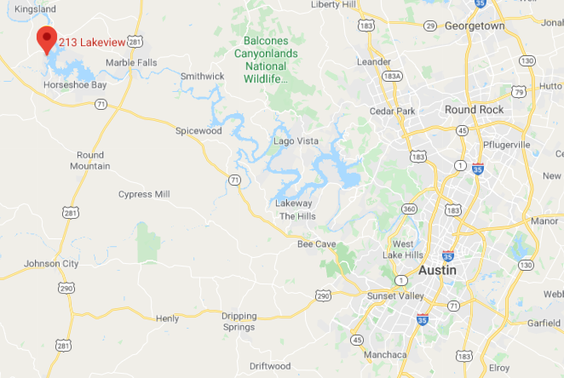
I speak Texan: hope y’all understand me!

Slide 5
OK, wait a minute!
Really need a gulp of coffee right now!
It’s just a little after 5am here in central Texas.
© 2020 | ByrdNest Consulting

Slide 6

OK, wait a minute!
I really need a gulp of coffee right now!
It’s just a little after 5am here in central Texas.
© 2020 | ByrdNest Consulting

Slide 7
Presentation slides and T-SQL code available at https://github.com/MByrdTX
Link to Video (YouTube.com) will be available shortly on www.sqlfriday.net
You don’t need to take notes; just listen and review slides and script later
© 2020 | ByrdNest Consulting

Slide 8
Overview
Fill Factor
What is it
How is it used?
Approach
Short Review of Code
Analysis
Conclusions/Observations
No Demos ☹
© 2020 | ByrdNest Consulting

Slide 9
Early version of code/presentation documented at https://www.sqlservercentral.com/articles/a-self-tuning-fill-factor-technique-for-sql-server-part-1
and https://www.sqlservercentral.com/articles/a-self-tuning-fill-factor-technique-for-sql-server-part-2
Early video from Austin User’s Group at http://usergroup.tv/videos/a-self-tuning-fill-factor-technique-for-sql-server
But latest code at GitHub/DropBox -- MByrdTX
© 2020 | ByrdNest Consulting

Slide 10
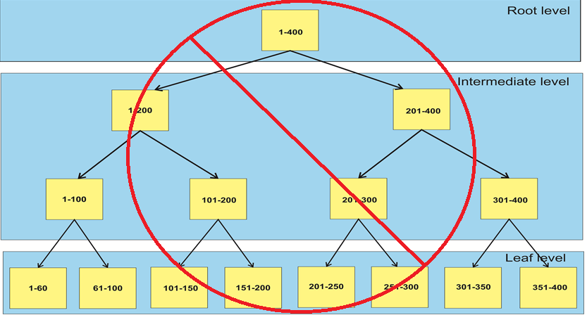
Index Structure (B-tree)

Slide 11
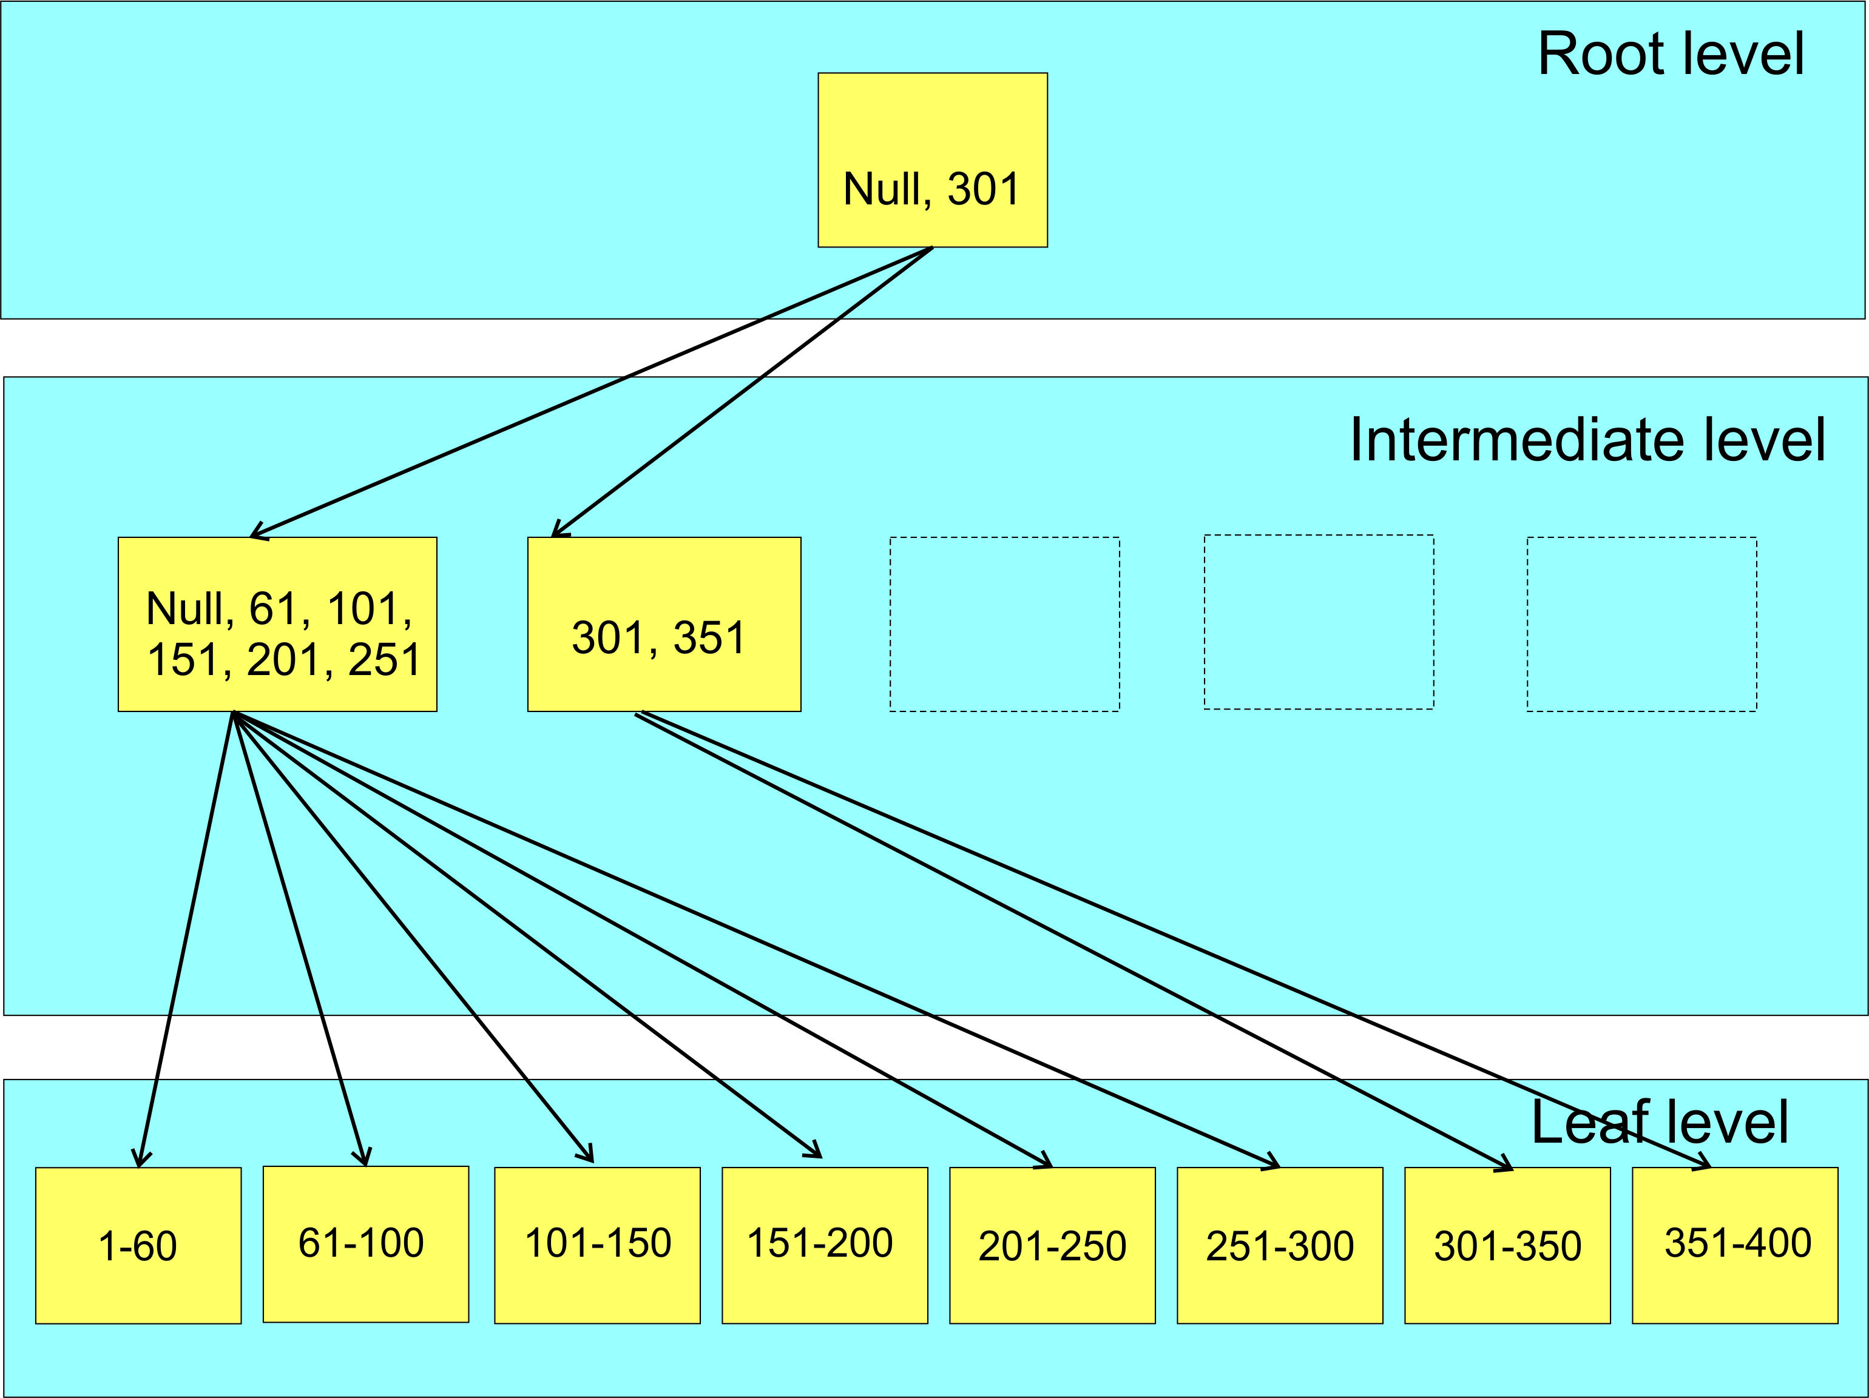
Index Structure (B-tree)
Root and Intermediate Level contain pointers to the data.
Left page boundary
Is always {NULL, NULL, ….}
Leaf Level contains index data (also the clustered index).

Slide 12

Fill Factor
Percent of fullness of leaf level pages of an index
So what happens when a page cannot accommodate a new row?
© 2020 | ByrdNest Consulting

Slide 13
SQL Server Fill Factor
SQL Server Fill Factor
Good Page Splits
Data added at end of table
Consecutive pages in an extent
Only last page is not full
© 2020 | ByrdNest Consulting

Slide 14
SQL Server Fill Factor
SQL Server Fill Factor
Good Page Splits
Bad Page Splits
Case study at https://www.sqlservercentral.com/articles/how-bad-are-bad-page-splits
Avg bad page split: cpu=0.035ms, logical IOs = 6.1
Gets both internal and external fragmentation
© 2020 | ByrdNest Consulting

Slide 15
SQL Server Fill Factor
SQL Server Fill Factor
Good Page Splits
Bad Page Splits
Case study at https://tinyurl.com/yd8mcmvk
Avg bad page split: cpu=0.035ms, logical IOs = 6.1
Trick is to find a value that minimizes bad page splits, but doesn’t result in an excessive storage penalty.
© 2020 | ByrdNest Consulting

Slide 16
Background
For last 4+ years I have really been diving into indexes and their effect on performance
But have never really understood how to determine a good fill factor value for an index
Some guidance, but no definite path
Just no definitive guidance!
What to do????
© 2020 | ByrdNest Consulting

Slide 17


In a time long, long ago…..
© 2020 | ByrdNest Consulting

Slide 18
Background
At speaker dinner for SQL Saturday 700 (Colorado Springs, March 2018) several other presenters said if you are so good with indexes, why don’t you do a presentation on fill factor?
© 2020 | ByrdNest Consulting

Slide 19
Background
At speaker dinner for SQL Saturday 700 (Colorado Springs, March 2018) several other presenters said if you are so good with indexes, why don’t you do a presentation on fill factor?
Last April 2019 at SQL Saturday 830 (Colorado Springs) I attended two sessions by Jeff Moden titled “Black Arts” Index Maintenance: How the “Best Practice” Methods are Silently Killing Performance.
These were outstanding
Can be downloaded from https://www.sqlsaturday.com/830/Sessions/Schedule.aspx
© 2020 | ByrdNest Consulting

Slide 20
Background
At speaker dinner for SQL Saturday 700 (Colorado Springs, March 2018) several other presenters said if you are so good with indexes, why don’t you do a presentation on fill factor?
Last April at SQL Saturday 830 (Colorado Springs) I attended two sessions by Jeff Moden titled “Black Arts” Index Maintenance: How the “Best Practice” Methods are Silently Killing Performance.
These were outstanding
Can be downloaded from https://www.sqlsaturday.com/830/Sessions/Schedule.aspx
A Reader’s Digest version of his presentations is contrary to the popular concept to reorganize at 10% fragmentation and rebuild indexes at 30%.
© 2020 | ByrdNest Consulting

Slide 21
Background
At speaker dinner for SQL Saturday 700 (Colorado Springs, March 2018) several other presenters said if you are so good with indexes, why don’t you do a presentation on fill factor?
Last April at SQL Saturday 830 (Colorado Springs) I attended two sessions by Jeff Moden titled “Black Arts” Index Maintenance: How the “Best Practice” Methods are Silently Killing Performance.
These were outstanding
Can be downloaded from https://www.sqlsaturday.com/830/Sessions/Schedule.aspx
A Reader’s Digest version of his presentations is contrary to the popular concept to reorganize at 10% fragmentation and rebuild indexes at 30%.
He showed (in the 2 presentations) that page splits caused tremendous performance degradations and that you should probably rebuild indexes at 1% fragmentation.
© 2020 | ByrdNest Consulting

Slide 22
Background
On the flight back home I got to thinking about everything he said and how fill factor also “factors” into index performance and maintenance.
© 2020 | ByrdNest Consulting

Slide 23
Background
On the flight back home I got to thinking about everything he said and how fill factor also “factors” into index performance and maintenance.
It got me to thinking about a brute force optimization technique I implemented way back when I worked at the Air Force Rocket Propulsion Laboratory (yes, I was once a rocket scientist and still a geek!).
© 2020 | ByrdNest Consulting

Slide 24
Background
On the flight back home I got to thinking about everything he said and how fill factor also “factors” into index performance and maintenance.
It got me to thinking about a brute force optimization technique I implemented way back when I worked at the Air Force Rocket Propulsion Laboratory (yes, I was once a rocket scientist and still a geek!).
It was a technique that involved tweaking various parameters (plus and minus percentages) and reducing the tweaks to an “optimum” solution.
© 2020 | ByrdNest Consulting

Slide 25
Background
On the flight back home I got to thinking about everything he said and how fill factor also “factors” into index performance and maintenance.
It got me to thinking about a brute force optimization technique I implemented way back when I worked at the Air Force Rocket Propulsion Laboratory (yes, I was once a rocket scientist and still a geek!).
It was a technique that involved tweaking various parameters (plus and minus percentages) and reducing the tweaks to an “optimum” solution.
It was not always perfect as in a multi-dimensional scenario there are valleys that this solution could drill down on, but it did offer “near” optimum solutions that let us explore options.
© 2020 | ByrdNest Consulting

Slide 26
Approach
Take a technique similar to Ola Hallengren’s defrag script and modify accordingly
© 2020 | ByrdNest Consulting

Slide 27
Approach
Take a technique similar to Ola Hallengren’s defrag script and modify accordingly
His script “reorganizes” at 10% fragmentation and “rebuilds” at 30% fragmentation
© 2020 | ByrdNest Consulting

Slide 28
Approach
Take a technique similar to Ola Hallengren’s defrag script and modify accordingly
His script “reorganizes” at 10% fragmentation and “rebuilds” at 30% fragmentation
I was already using his script with no Reorganize and Rebuilds at 10%.
© 2020 | ByrdNest Consulting

Slide 29
Approach
Take a technique similar to Ola Hallengren’s defrag script and modify accordingly
His script “reorganizes” at 10% fragmentation and “rebuilds” at 30% fragmentation
I was already using his script with no Reorganize and Rebuilds at 10%.
Need to track fragmentation vs fill factor for each index (heaps not counted)
© 2020 | ByrdNest Consulting

Slide 30
Approach
Take a technique similar to Ola Hallengren’s defrag script and modify accordingly
His script “reorganizes” at 10% fragmentation and “rebuilds” at 30% fragmentation
I was already using his script with no Reorganize and Rebuilds at 10%.
Need to track performance and fragmentation for each index (heaps not counted)
Need a table to contain the parametrics involved with the whole rebuild process for each rebuild
© 2020 | ByrdNest Consulting

Slide 31
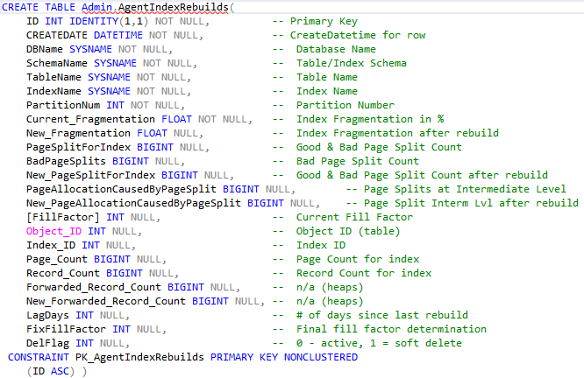
Admin.AgentIndexRebuilds (as it exists today, much evolution)
© 2020 | ByrdNest Consulting

Slide 32
Approach
Take a technique similar to Ola Hallengren’s defrag script and modify accordingly
His script “reorganizes” at 10% fragmentation and “rebuilds” at 30% fragmentation
I was already using his script with no Reorganize and Rebuilds at 10%.
Need to track performance and fragmentation for each index (heaps not counted)
Need a table to contain the parametrics involved with the whole rebuild process for each rebuild
Get TOP 20 indexes with worse fragmentation / bad page splits.
© 2020 | ByrdNest Consulting

Slide 33
Approach
Take a technique similar to Ola Hallengren’s defrag script and modify accordingly
His script “reorganizes” at 10% fragmentation and “rebuilds” at 30% fragmentation
I was already using his script with no Reorganize and Rebuilds at 10%.
Need to track performance and fragmentation for each index (heaps not counted)
Need a table to contain the parametrics involved with the whole rebuild process for each rebuild
Get TOP 20 indexes with worse fragmentation / bad page splits.
20 worked best for this database; can be changed!
© 2020 | ByrdNest Consulting

Slide 34
Fragmentation
From Ola’s defrag script we can get average fragmentation in percent
sys.dm_db_index_physical_stats
Yields Average_fragmentation_in_percent, page_count, row_count
sys.dm_db_index_operational_stats
Yields Leaf_Allocation_Count, NonLeaf_Allocation_Count
© 2020 | ByrdNest Consulting

Slide 35
Fragmentation
From Ola’s defrag script we can get average fragmentation in percent
sys.dm_db_index_physical_stats
Yields Average_fragmentation_in_percent, page_count, row_count
sys.dm_db_index_operational_stats
Yields Leaf_Allocation_Count, NonLeaf_Allocation_Count
Extended event (track bad page splits)
https://www.sqlskills.com/blogs/jonathan/tracking-problematic-pages-splits-in-sql-server-2012-extended-events-no-really-this-time/
© 2020 | ByrdNest Consulting

Slide 36
Fragmentation
But fragmentation consists of
Logical fragmentation
Fragmentation of database file(s) in the file system
Uniform Extents are owned by one object
Mixed Extents can be shared by up to 8 objects
All new (or rebuilt) indexes are allocated pages from a mixed extent
© 2020 | ByrdNest Consulting

Slide 37
Fragmentation
But fragmentation consists of
Logical fragmentation
Fragmentation of database file(s) in the file system
Uniform Extents are owned by one object
Mixed Extents can be shared by up to 8 objects
All new indexes are allocated pages from a mixed extent
Index Level fragmentation
Internal fragmentation (too much free space)
External fragmentation (Pages out of order, also free space)
© 2020 | ByrdNest Consulting

Slide 38
Internal Fragmentation
Internal fragmentation is measured in average page fullness (page density)
A page that is 100% full has no internal fragmentation
Can occur with deletes or where next row cannot fit into the existing page (bad page split).
Will increase I/O
Decreases efficiency of buffer cache
Increase size of the database file
Will have after index rebuild with Fill Factor < 100
http://www.practicalsqldba.com/2012/04/sql-server-index-fragmentation.html
© 2020 | ByrdNest Consulting

Slide 39
External Fragmentation
Happens when logical order of the pages does not match the physical order of the pages.
Measured as percentage of out-of-order pages in the leaf pages of an index.
© 2020 | ByrdNest Consulting

Slide 40
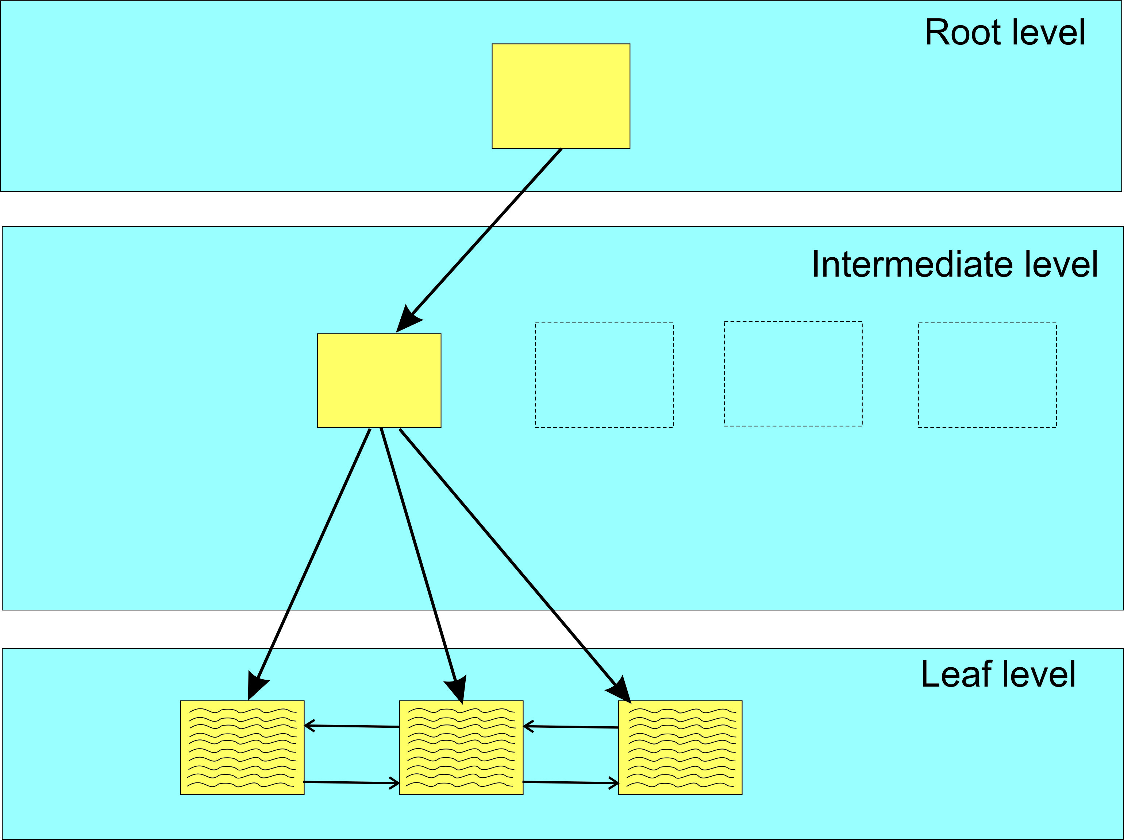
Partial view of B-Tree before adding row
© 2020 | ByrdNest Consulting

Slide 41
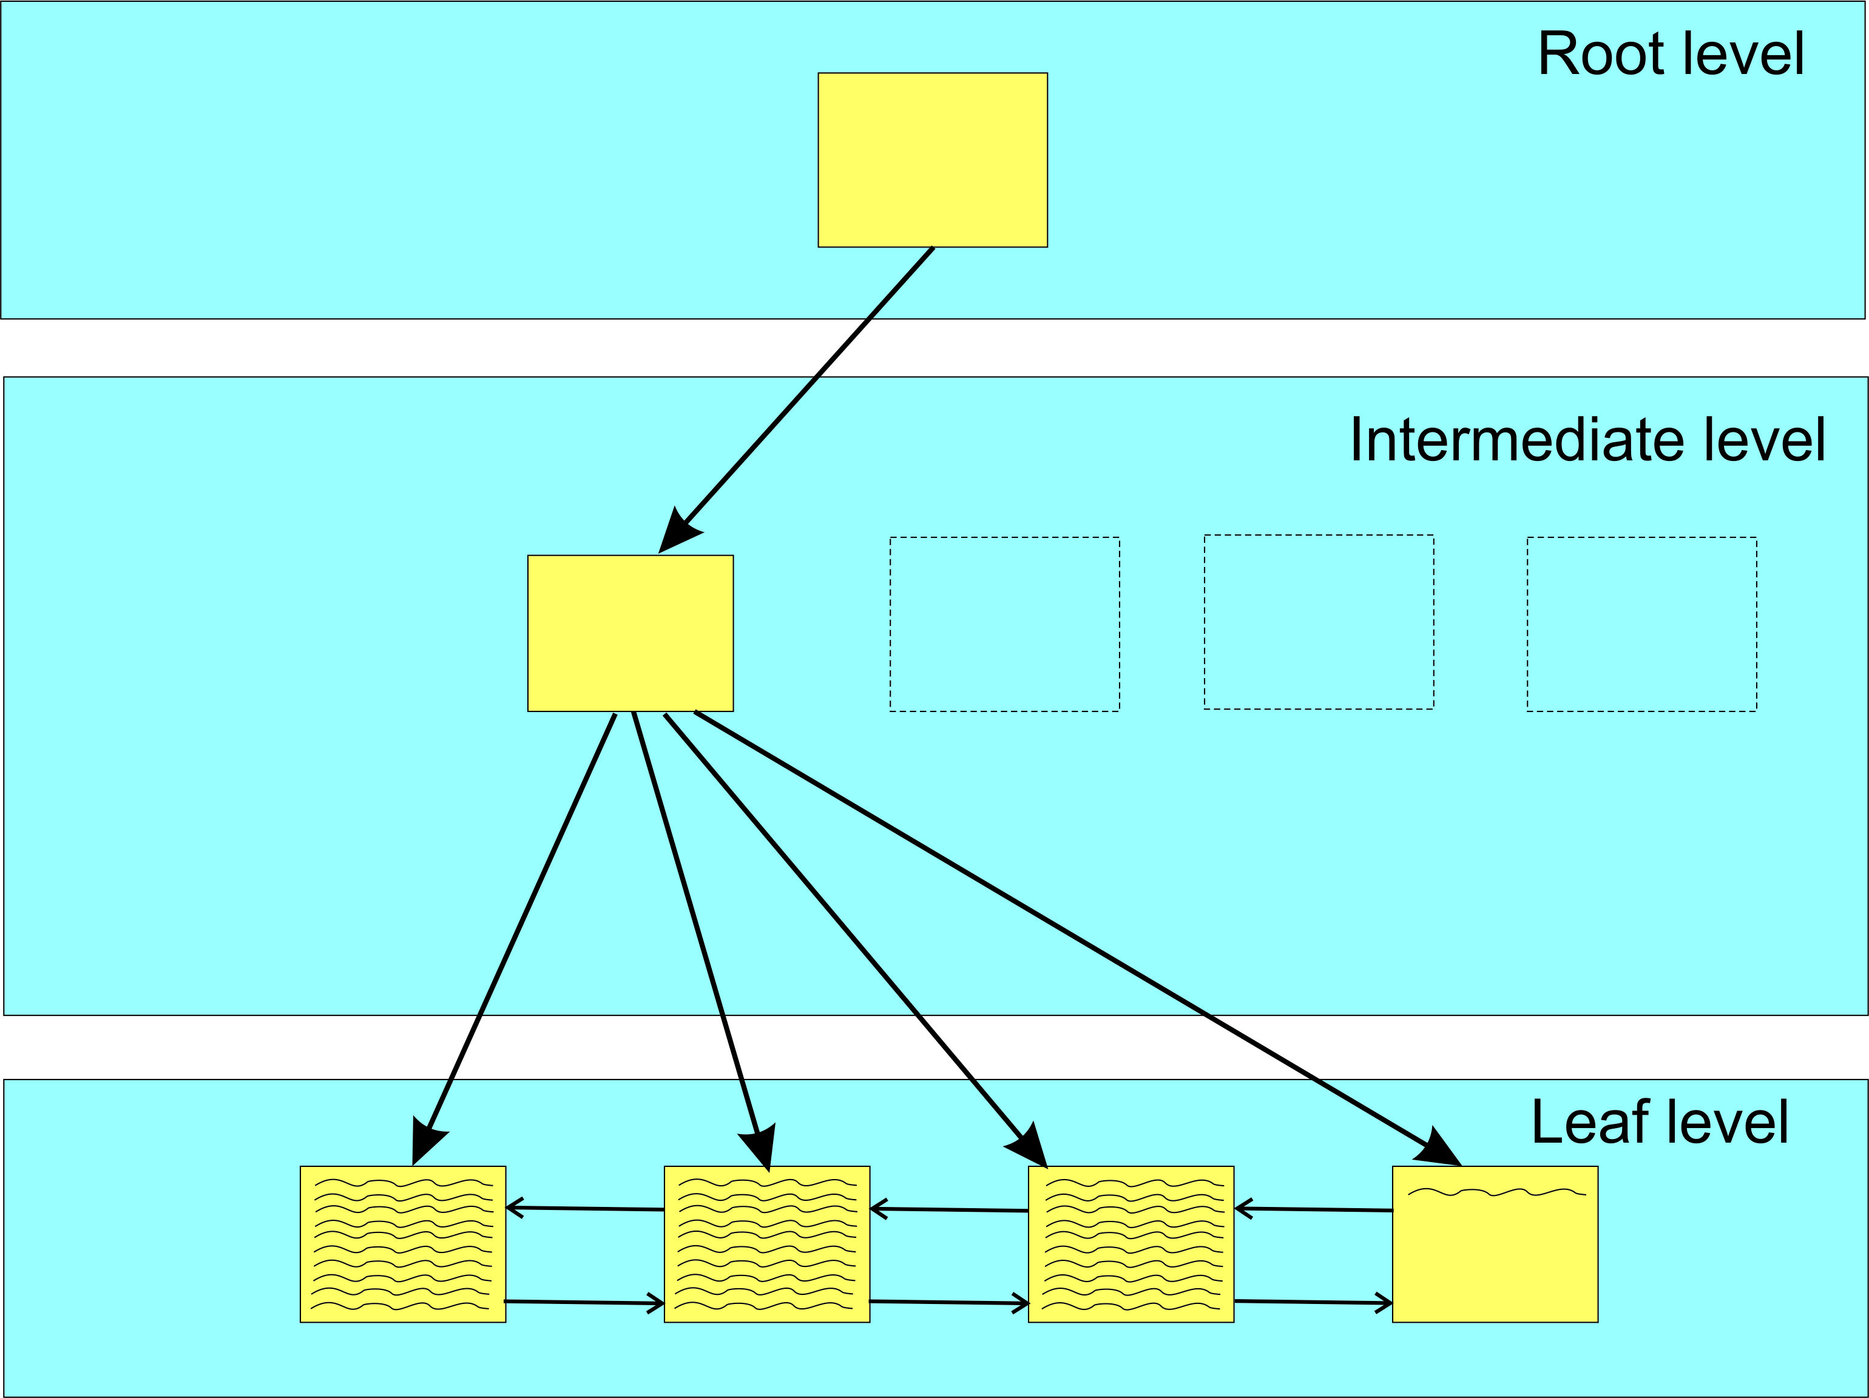
After adding row to index (Identity column)
Good Page Split
© 2020 | ByrdNest Consulting

Slide 42
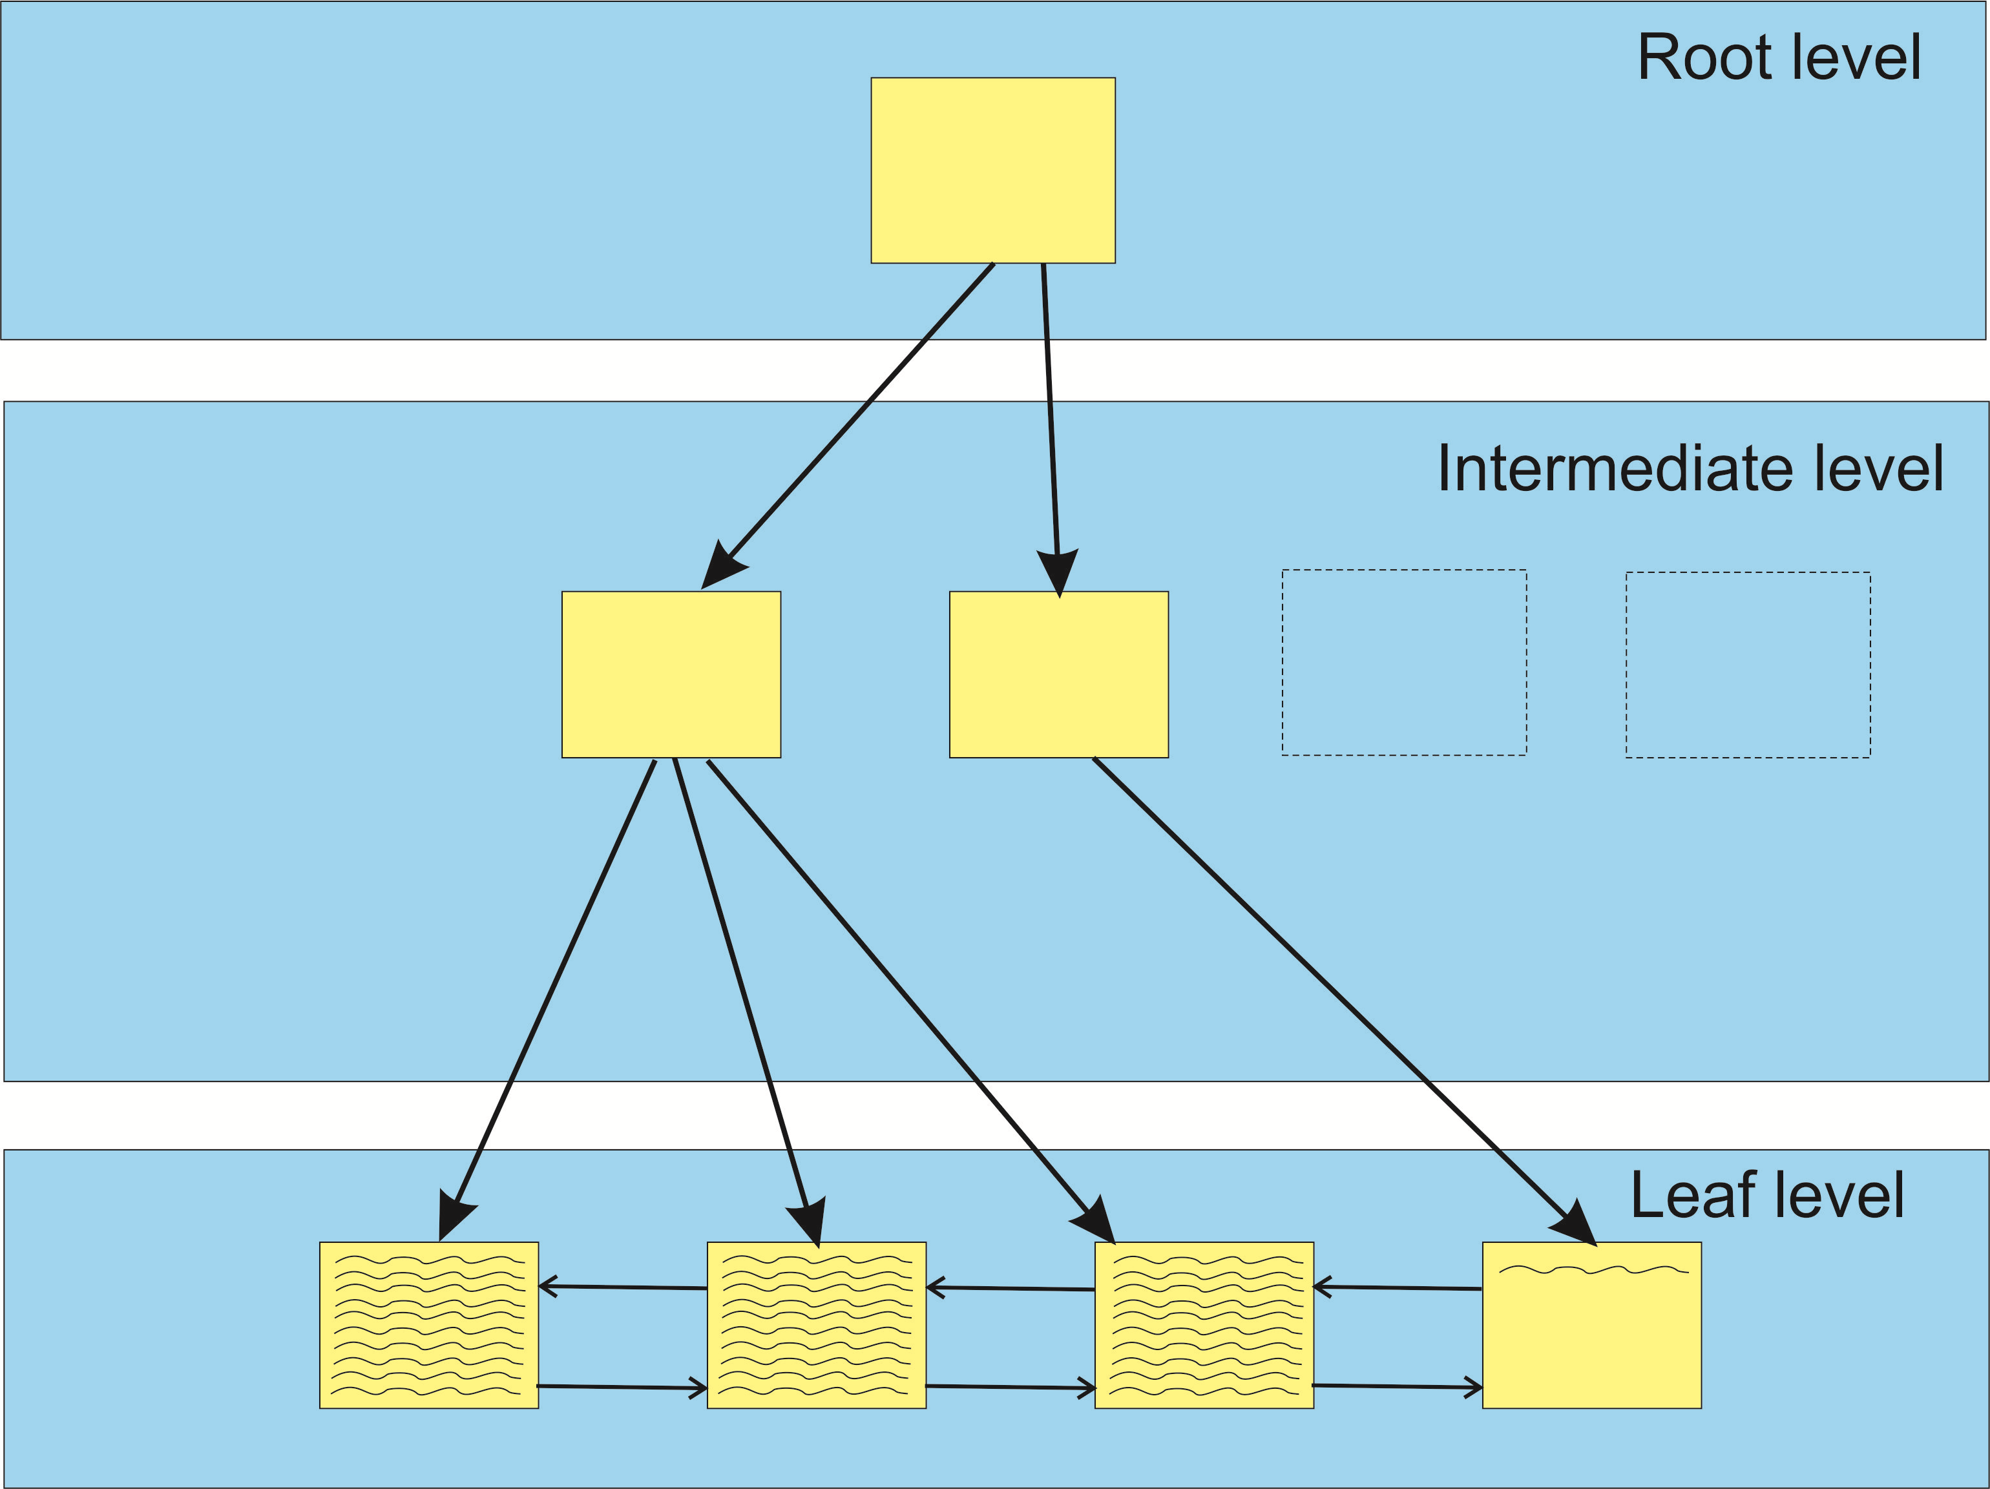
After adding row to index (Identity column, Inter. node expansion)
Good Page Split
© 2020 | ByrdNest Consulting

Slide 43
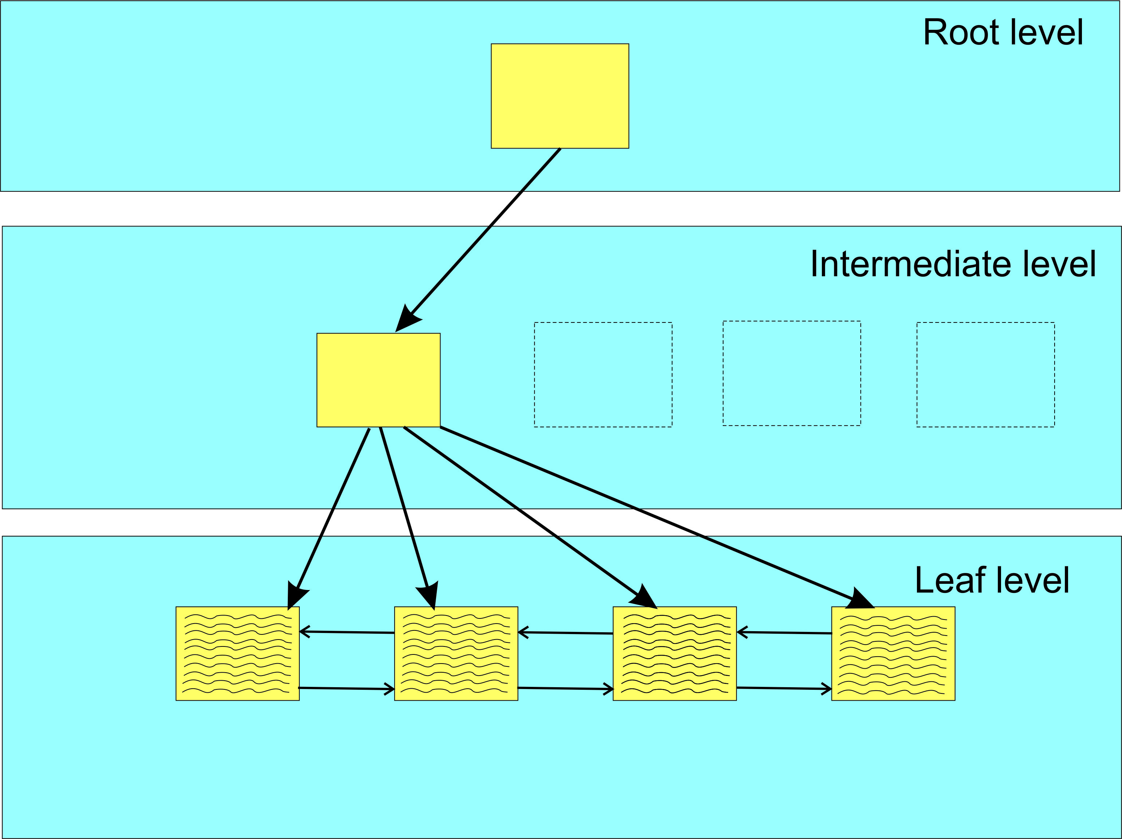
Bad Page Split Example (before row insert, rows aligned with extent)
© 2020 | ByrdNest Consulting

Slide 44
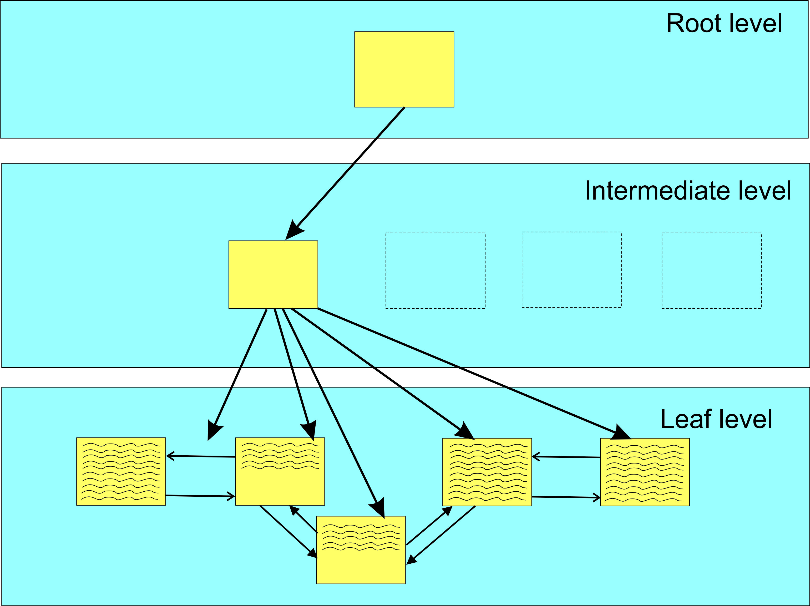
Bad Page Split Example (after row insert, rows not aligned with extent)
All the data
moved is logged
in transaction log
Bad Page Split
© 2020 | ByrdNest Consulting

Slide 45
Code
Demo: FillFactorIndexSetup.sql
SQLAgentScriptRebuildIndexes.sql
© 2020 | ByrdNest Consulting

Slide 46
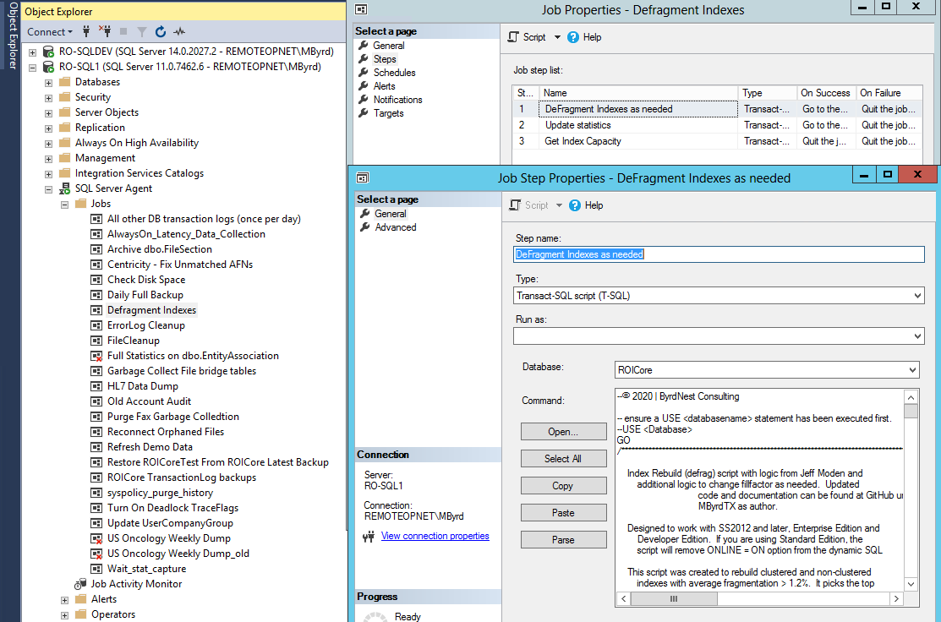
SQL Agent Job
© 2020 | ByrdNest Consulting

Slide 47
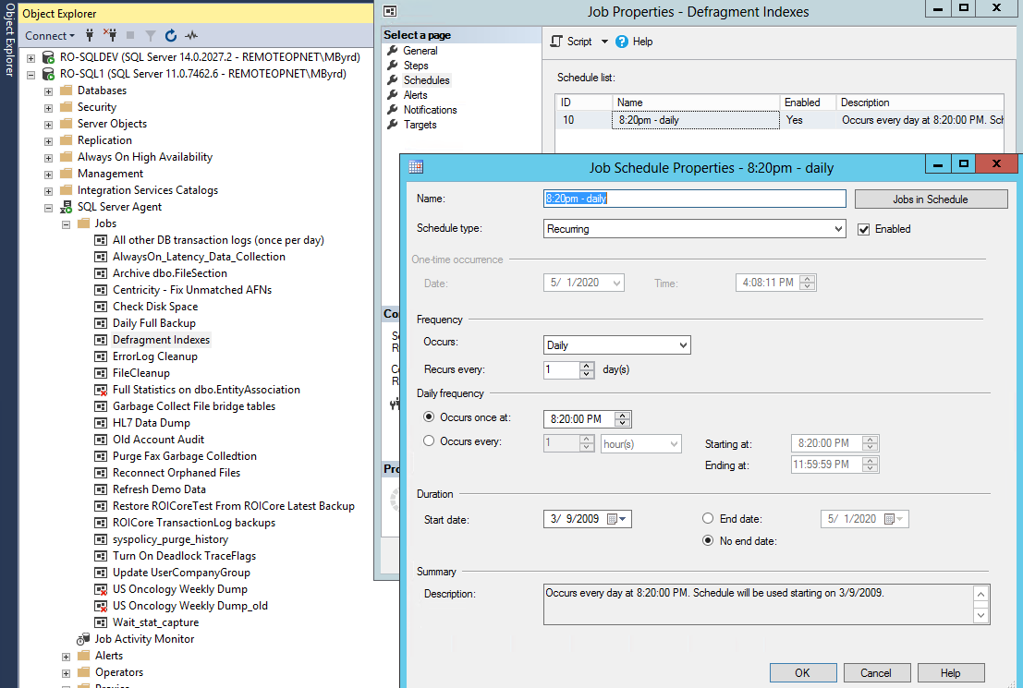
SQL Agent Job
© 2020 | ByrdNest Consulting

Slide 48
Analysis -1
Initially set up SQL Agent job (nightly) to collect data and vary fill-factor from 100 (default) down
Run during low database activity
As data collected, added new columns to history table and revised logic to determine and/or fix fill factor for each index
Eventually saw need to re-tweak fill factors after period of time (90 days) to allow for new patterns in data access (app changes, data skew)
© 2020 | ByrdNest Consulting

Slide 49
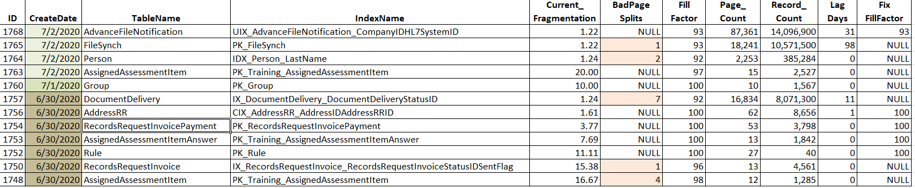
Analysis -2: Recent Results from [Admin].AgentIndexRebuilds
© 2020 | ByrdNest Consulting

Slide 50
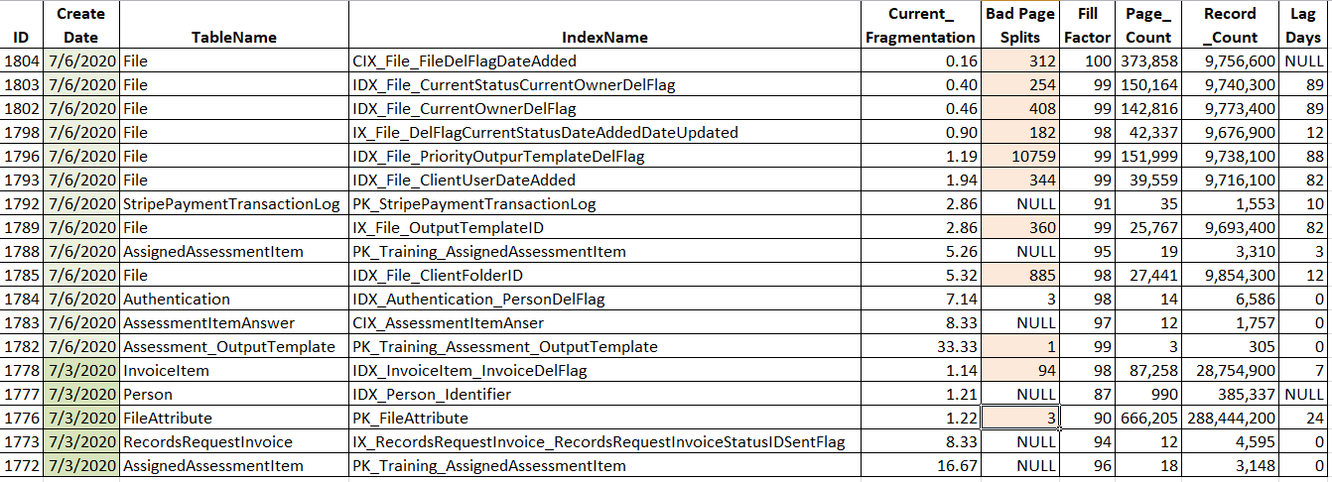
Analysis -3: Recent Results from [Admin].AgentIndexRebuilds
© 2020 | ByrdNest Consulting

Slide 51
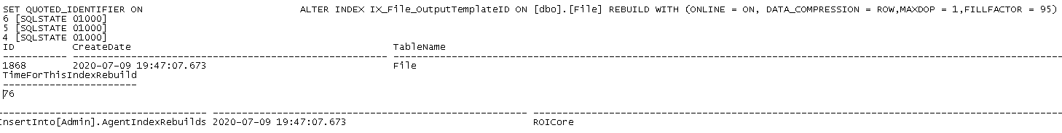
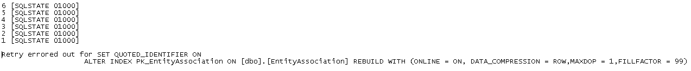
Analysis -4: Results from DeFragLog (20200709)
Deadlocks Encountered, 2 retries before successful
Deadlocks Encountered, failed after 6 tries (no row inserted into AgentIndexRebuilds)
© 2020 | ByrdNest Consulting

Slide 52
Analysis -5
Ran data collection on very active client OLTP database
225gb real data (not including sprocs, views, etc.)
249 tables
694 indexes
24x7 environment
In 90 day period only 164 indexes (clustered & nonclustered) recorded and fill factor “tweaked”.
© 2020 | ByrdNest Consulting

Slide 53
Indexes encountered
Clustered Index
Based on sequential increase (Identity Column)
Based on Parent Table plus primary key
FileAttribute table {FileID, FileAttributeID, PK = FileAttributeID}
Non-Clustered Index
Usually based on non PK column
© 2020 | ByrdNest Consulting

Slide 54
Analysis – 3: Clustered Index based on identity column
Date | ID | Index Name | Current Fragmentation | New Fragmentation | Page Split For Index | New Page Split For Index | Fill Factor
4/17/2019 | 125 | A_C | 5.5529 |  |  |  | 91
4/28/2019 | 324 | A_C | 1.2012 |  |  |  | 89
5/7/2019 | 551 | A_C | 1.0641 |  |  |  | 88
5/19/2019 | 745 | A_C | 1.3925 | 0.0214 | 6246 | 1 | 87
6/1/2019 | 940 | A_C | 1.4646 | 0.0254 | 6781 | 1 | 88
6/12/2019 | 1130 | A_C | 1.2421 | 0.0336 | 5822 | 1 | 88
© 2020 | ByrdNest Consulting

Slide 55
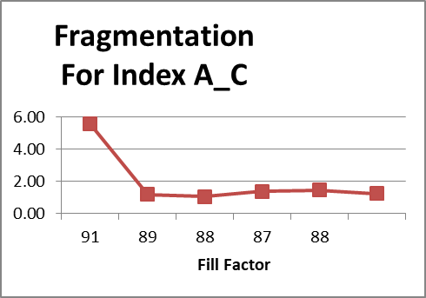
Analysis – 3b: Clustered Index based on identity column
© 2020 | ByrdNest Consulting

Slide 56
Analysis – 4: Clustered Index (many rows inserted within interior pages)
Date | ID | Index Name | Current Fragmentation | New Fragmentation | Page Split For Index | New Page Split For Index | Fill Factor
4/17/2019 | 113 | B_C | 6.548705 |  |  |  | 100
4/25/2019 | 247 | B_C | 1.599545 |  |  |  | 99
4/30/2019 | 377 | B_C | 5.436387 |  |  |  | 98
5/1/2019 | 407 | B_C | 4.856919 |  |  |  | 97
5/7/2019 | 549 | B_C | 1.174713 |  |  |  | 96
5/16/2019 | 691 | B_C | 1.756837 | 0.221820894 | 1037 | 1 | 95
5/24/2019 | 815 | B_C | 1.523979 | 0.233713691 | 897 | 1 | 96
6/2/2019 | 950 | B_C | 1.214119 | 0.220436191 | 644 | 1 | 96
6/7/2019 | 1046 | B_C | 1.151839 | 0.232396003 | 656 | 1 | 96
6/14/2019 | 1167 | B_C | 1.212156 | 0.226648484 | 751 | 1 | 96
© 2020 | ByrdNest Consulting

Slide 57
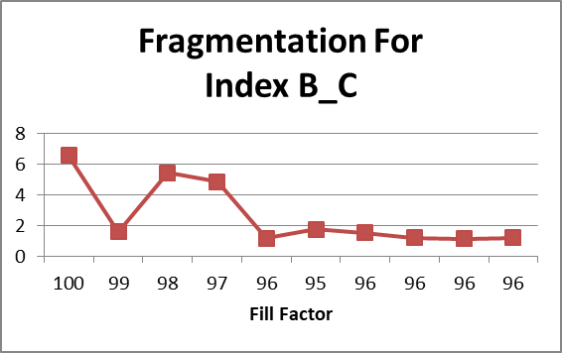
Analysis – 4b: Clustered Index (many rows inserted within interior pages)
© 2020 | ByrdNest Consulting

Slide 58
Analysis – 5: Non-Clustered Index (random interior inserts)
Date | ID | Index Name | Current Fragmentation | New Fragmentation | Page Split For Index | New Page Split For Index | Fill Factor
4/12/2019 | 47 | C_N | 10.92865 |  |  |  | 93
4/17/2019 | 120 | C_N | 5.816024 |  |  |  | 92
4/21/2019 | 172 | C_N | 3.196622 |  |  |  | 91
4/24/2019 | 225 | C_N | 1.979109 |  |  |  | 89
4/26/2019 | 270 | C_N | 1.603421 |  |  |  | 87
4/28/2019 | 328 | C_N | 1.261167 |  |  |  | 85
4/29/2019 | 366 | C_N | 1.029336 |  |  |  | 83
5/1/2019 | 427 | C_N | 1.201803 |  |  |  | 81
5/3/2019 | 465 | C_N | 1.214772 |  |  |  | 79
5/5/2019 | 500 | C_N | 1.145038 |  |  |  | 77
5/8/2019 | 568 | C_N | 1.340111 |  |  |  | 75
5/15/2019 | 685 | C_N | 2.558348 | 0.262582057 | 53 | 1 | 73
5/18/2019 | 730 | C_N | 1.598963 | 0.252631579 | 31 | 1 | 71
5/21/2019 | 776 | C_N | 1.445578 | 0.298359025 | 22 | 1 | 83
5/24/2019 | 823 | C_N | 2.347188 | 0.29455081 | 37 | 1 | 83
5/25/2019 | 834 | C_N | 1.597289 | 0.290697674 | 30 | 1 | 83
5/26/2019 | 848 | C_N | 1.456311 | 0.292255236 | 27 | 1 | 83
5/27/2019 | 864 | C_N | 1.681884 | 0.288461538 | 29 | 1 | 83
5/28/2019 | 877 | C_N | 1.379638 | 0.285986654 | 23 | 1 | 83
5/31/2019 | 926 | C_N | 1.556604 | 0.283822138 | 26 | 1 | 83
6/3/2019 | 968 | C_N | 1.342616 | 0.3 | 16 | 1 | 83
6/5/2019 | 1015 | C_N | 1.535414 | 0.298210736 | 22 | 1 | 83
6/7/2019 | 1055 | C_N | 1.330705 | 0.296735905 | 17 | 1 | 83
6/9/2019 | 1082 | C_N | 1.118568 | 0.281531532 | 8 | 1 | 83
6/11/2019 | 1115 | C_N | 1.563372 | 0.280269058 | 17 | 1 | 83
6/13/2019 | 1156 | C_N | 1.551247 | 0.277932185 | 21 | 1 | 83
6/15/2019 | 1193 | C_N | 1.102536 | 0.276243094 | 16 | 1 | 83
© 2020 | ByrdNest Consulting

Slide 59
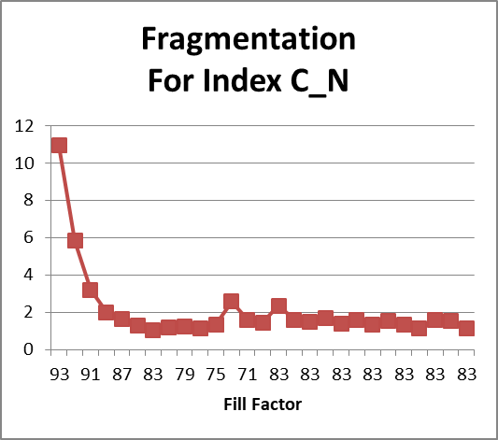
Analysis – 5b: Non-Clustered Index (random interior inserts)
© 2020 | ByrdNest Consulting

Slide 60
Analysis – 6: Non-Clustered Index (random interior inserts)
Date | ID | Index Name | Current Fragmentation | New Fragmentation | Page Split For Index | New Page Split For Index | Fill Factor
4/15/2019 | 86 | D_N | 8.433735 |  |  |  | 85
4/28/2019 | 349 | D_N | 1.075269 |  |  |  | 83
4/29/2019 | 375 | D_N | 1.052632 |  |  |  | 81
4/30/2019 | 404 | D_N | 1.030928 |  |  |  | 79
5/13/2019 | 658 | D_N | 9.009009 | 0.884955752 | 11 | 1 | 77
© 2020 | ByrdNest Consulting

Slide 61
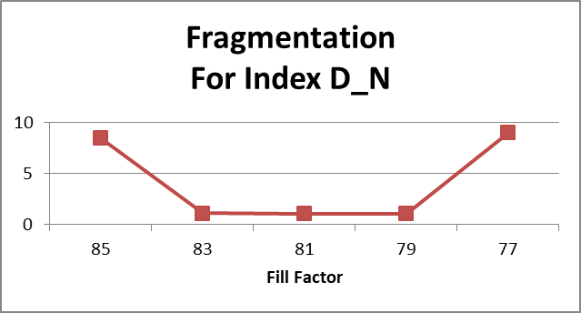
Analysis – 6b: Non-Clustered Index (random interior inserts)
© 2020 | ByrdNest Consulting

Slide 62
Thought process for fixing fill factor
Collect at least 6 data sets for each index
Find smallest fragmentation
But not last data set
If 6th data set fragmentation is smallest, then continue to perturb the fill factor on the next run(s) for that index
Identify fill factor for the smallest fragmentation and set FixFillFactor
Script then checks FixFillFactor and stops tweaking when not null.
© 2020 | ByrdNest Consulting

Slide 63
Analysis
Unfortunately did not have good benchmarks for performance, but…….
© 2020 | ByrdNest Consulting

Slide 64
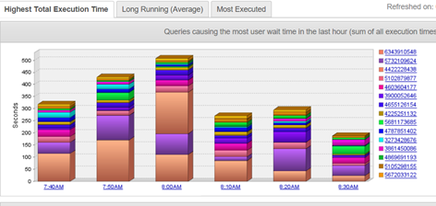
Analysis: : DPA screen shot from late Feb 2019 (Typical Server Performance during the day)
© 2020 | ByrdNest Consulting

Slide 65
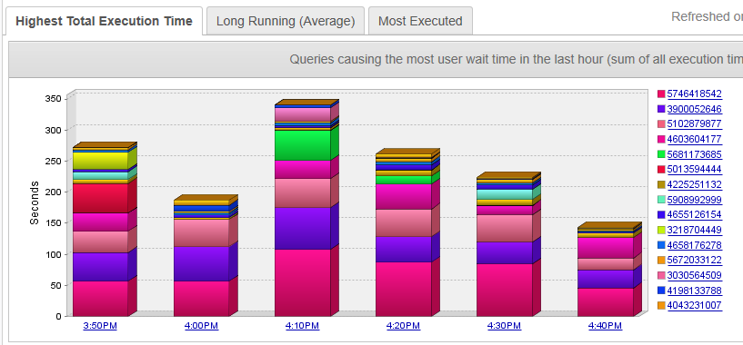
Analysis: : DPA screen shot from late June 2019 (Typical Server Performance during the day)
© 2020 | ByrdNest Consulting

Slide 66
Analysis: Performance
Overall decrease in database wait times of about 30%
{Yes I know different times, but screen shots are indicative of performance through the day.}
© 2020 | ByrdNest Consulting

Slide 67
Analysis: Performance
Overall decrease in database wait times of about 30%
With decreased fragmentation, there are less page splits to wade through for IO range searches
© 2020 | ByrdNest Consulting

Slide 68
Analysis: Performance
Overall decrease in database wait times of about 30%
With decreased fragmentation, there are less page splits to wade through for IO range searches
With improved fill factor, there are less bad page splits.
The cost of a page split can be significant.
First the new page has to be identified, pointers made to it, data movement from the old page to the new page and finally all of this is logged.
© 2020 | ByrdNest Consulting

Slide 69
Requirements
SQL Server 2012 and above
Enterprise version recommended (OnLine option)
Standard Edition can be used, but have to be wary of schema locks.
Data compression = ROW recommended
Already have in Enterprise
Have in SS2016 SP2 and above for Standard Edition
© 2020 | ByrdNest Consulting

Slide 70
Wish List
Add code for multiple databases on same server
May want to have separate database for history table
© 2020 | ByrdNest Consulting

Slide 71
Wish List
Add code for multiple databases on same server
Still would be nice to determine best performance for fill factor value vs pages used.
© 2020 | ByrdNest Consulting

Slide 72
Wish List
Add code for multiple databases on same server
Finalize and catch all edge conditions not currently accounted for
Rewrite code (current code is from proof of concept) – I intend to clean it up in the near future
© 2020 | ByrdNest Consulting

Slide 73
Wish List
Add code for multiple databases on same server
Finalize and catch all edge conditions not currently accounted for
Rewrite code (current code is from proof of concept) – I intend to clean it up in the near future
Current fill factor approach not implemented for partitioned indexes (it would really be nice to have fill factor per partition; that way the old data partitions could be set to 100% and the active partitions set as needed {this should be placed on Microsoft’s wish list ☺} ).
© 2020 | ByrdNest Consulting

Slide 74
Wish List
Add code for multiple databases on same server
Finalize and catch all edge conditions not currently accounted for
Rewrite code (current code is from proof of concept) – I intend to clean it up in the near future
Current fill factor approach not implemented for partitioned indexes (it would really be nice to have fill factor per partition; that way the old data partitions could be set to 100% and the active partitions set as needed {this should be placed on Microsoft’s wish list ☺} ).
Try and build in additional features as suggested by the community
© 2020 | ByrdNest Consulting

Slide 75
Wish List
Add code for multiple databases on same server
Finalize and catch all edge conditions not currently accounted for
Rewrite code (current code is from proof of concept) – I intend to clean it up in the near future
Current fill factor approach not implemented for partitioned indexes (it would really be nice to have fill factor per partition; that way the old data partitions could be set to 100% and the active partitions set as needed {this should be placed on Microsoft’s wish list ☺} ).
Try and build in additional features as suggested by the community
More testing on performance improvements with firm numbers.
© 2020 | ByrdNest Consulting

Slide 76
Wish List
Add code for multiple databases on same server
Finalize and catch all edge conditions not currently accounted for
Rewrite code (current code is from proof of concept) – I intend to clean it up in the near future
Current fill factor approach not implemented for partitioned indexes (it would really be nice to have fill factor per partition; that way the old data partitions could be set to 100% and the active partitions set as needed {this should be placed on Microsoft’s wish list ☺} ).
Try and build in additional features as suggested by the community
More testing on performance improvements with firm numbers.
Need better way of monitoring Admin.AgentIndexRebuilds – both manually and also self-reviewing.
Any volunteers out there to implement a dash board???
© 2020 | ByrdNest Consulting

Slide 77

Wish List
Add code for multiple databases on same server
Finalize and catch all edge conditions not currently accounted for
Research extended events to identity “bad” page splits
Rewrite code (current code is from proof of concept) – I intend to clean it up in the near future
Current fill factor approach not implemented for partitioned indexes (it would really be nice to have fill factor per partition; that way the old data partitions could be set to 100% and the active partitions set as needed {this should be placed on Microsoft’s wish list ☺} ).
Try and build in additional features as suggested by the community
More testing on performance improvements with firm numbers.
Need better way of monitoring Admin.AgentIndexRebuilds – both manually and also self-reviewing.
Any volunteers out there to implement a dash board???
Code into GitHub (MByrdTX)
© 2020 | ByrdNest Consulting

Slide 78
Wish List
Add code for multiple databases on same server
Finalize and catch all edge conditions not currently accounted for
Research extended events to identity “bad” page splits
Rewrite code (current code is from proof of concept) – I intend to clean it up in the near future
Current fill factor approach not implemented for partitioned indexes (it would really be nice to have fill factor per partition; that way the old data partitions could be set to 100% and the active partitions set as needed {this should be placed on Microsoft’s wish list ☺} ).
Try and build in additional features as suggested by the community
More testing on performance improvements with firm numbers.
Need better way of monitoring Admin.AgentIndexRebuilds – both manually and also self-reviewing.
Any volunteers out there to implement a dash board???
Need to get code into GitHub (MByrdTX)
Are nightly rebuilds necessary?
Jeff Moden/Brent Ozar don’t think so
IMHO, yes to establish Fill Factor, then perhaps weekly or monthly?
Compare index growth
© 2020 | ByrdNest Consulting

Slide 79
Wish List
Add code for multiple databases on same server
Finalize and catch all edge conditions not currently accounted for
Research extended events to identity “bad” page splits
Rewrite code (current code is from proof of concept) – I intend to clean it up in the near future
Current fill factor approach not implemented for partitioned indexes (it would really be nice to have fill factor per partition; that way the old data partitions could be set to 100% and the active partitions set as needed {this should be placed on Microsoft’s wish list ☺} ).
Try and build in additional features as suggested by the community
More testing on performance improvements with firm numbers.
Need better way of monitoring Admin.AgentIndexRebuilds – both manually and also self-reviewing.
Any volunteers out there to implement a dash board???
Need to get code into GitHub (MByrdTX)
Are nightly rebuilds necessary?
Jeff Moden/Brent Ozar don’t think so
IMHO, yes to establish Fill Factor, then perhaps weekly or monthly?
Compare index growth
Should we base fill factor index selection only on Bad Page Splits???
© 2020 | ByrdNest Consulting

Slide 80
Ongoing Work
Still monitoring and analyzing!
© 2020 | ByrdNest Consulting

Slide 81

Conclusions
This whole idea started as a proof of concept
Offers potential performance benefits
Does demonstrate that effective automatic determination of Fill Factor IS possible
Current code in production for 15 months
Code both defrags and determines fillfactor.
© 2020 | ByrdNest Consulting

Slide 82
Conclusions
Only slowness complaint from client is from new stored procedures from developers without my review
Remember I am only a part-time T-SQL developer serving also as an accidental DBA!
© 2020 | ByrdNest Consulting

Slide 83
Finally
This concept has been copyrighted with the idea that it belongs to the SQL Server Community.
I look forward to constructive critique and suggestions for improvements from the SQL Server Community
© 2020 | ByrdNest Consulting

Slide 84

Finally
Questions?
© 2020 | ByrdNest Consulting

